Slide 1
AI-Powered Multi-Agent SDLC Foundry From Requirements to Code – 10x Faster with Autonomous AI Agents Transforming Business Requirements into Production-Ready Automation Using Autonomous AI Agents
Built on UiPath Agentic Automation Platform
Team, 👥 Foundry Engineers

Slide 2




Agentic Minds​
Komal Melkunde
Vijay Yadav
Madhu Preethi Kakarla
Vandana Anchan
RPA Developer | AI Specialist
komal-sanjeev.melkunde@capgemini.com
RPA Developer | AI Specialist
vijay-lalmani.yadav@capgemini.com
RPA Developer | AI Specialist
madhukakarla98@gmail.com
Solution Architect
vandana.anchan@capgemini.com

Slide 3

Problem statement and proposed solution
From Weeks of Effort → Minutes to Delivery
Current State
The Shift
Solution
✅ AI-driven Requirement Intelligence
✅ Auto-generated PDD, SDD
✅ Code generation
✅ Test case generation
✅ Seamless agent-driven handoffs and review flexibility
❌ Fragmented Requirements
❌ Manual PDD/SDD creation
❌ Delayed development start
❌ Poor test coverage
❌ Inefficient handoffs
Idea → Implementation in Minutes

Slide 4





Benefits and technologies used
What We Built
An AI-driven solution that automates the entire software development lifecycle — from requirement analysis to testing and deployment — using intelligent agents.
How It Works
Business Impact
AI Orchestration Layer
Multi-agent workflows (planning, coding, testing)
UiPath Maestro + Agent Builder
Development Automation
Auto-generate code, workflows, and documentation
UiPath Studio + Autopilot
Deployment & Ops
One-click deployment pipelines
UiPath Orchestrator
Intelligent Testing
AI-generated test cases + validation
UiPath Test Manager
LLM Backbone
GPT / Claude for reasoning, generation, and decisioning
Productivity Boost
Developers focus on innovation, not repetitive tasks
80%
Faster SDLC execution
From weeks → hours/minutes
⚡
🚀
🧠 AI-driven Decision Automated requirement analysis, code generation, and testing
Built-in Governance Human-in-the-loop validation
✅

Slide 5
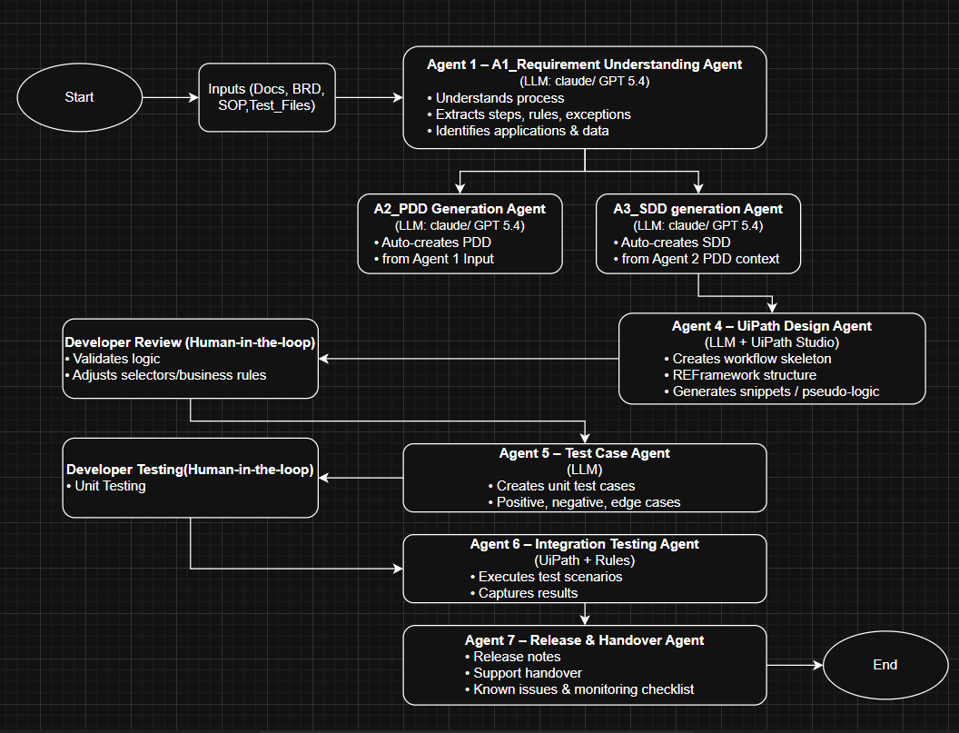
SDLC Foundry - Multi-Agent AI Architecture
Technology Mapping
Orchestration: UiPath Maestro
Agent Logic: Agent Builder
Development: UiPath Studio
Execution: Orchestrator
AI Models: GPT / Claude
Key Differentiators
7 AI agents collaborating like a real delivery team
End-to-end SDLC automation (Idea → Production)
Context shared across agents (no silos)
Massive acceleration (hours → minutes)

Slide 6
Transforming the Future of SDLC with AI Agents
What We Achieved
Metric | Outcome
📄 Documents Generated | 4+ artifacts auto-created (BRD, Design, Test Cases, Release Notes)
🤖 AI Agents | 5 Specialized Agents (Planner, Architect, Developer, Tester, Reviewer)
⏱ Documentation Time | Reduced from Hours → Minutes
👨‍💻 Manual Effort | Reduced by ~80%
🔄 SDLC Coverage | Requirement → Design → Build → Test → Deploy Ready
What if your next project starts with 5 AI architects working instantly?
Turn ideas into deliverables in minutes
Eliminate repetitive work
Enable teams to focus on innovation, not execution

Slide 7
The Future of SDLC Starts Here.

